Slide 1
Pressure drop measurement
Rijk Hogenbirk
07/11/2019

Slide 2
Setup
Shut off main chamber and close off main pressure controller
Prepare everything in low vacuum (0.04 bar)
Fill only hydrogen and air chambers with 1 bar air
Let that air expand into mixing chamber and shut off pressure controller
Set pressure controller to 10V (open) and measure pressure that should be lower than 10V

Slide 3
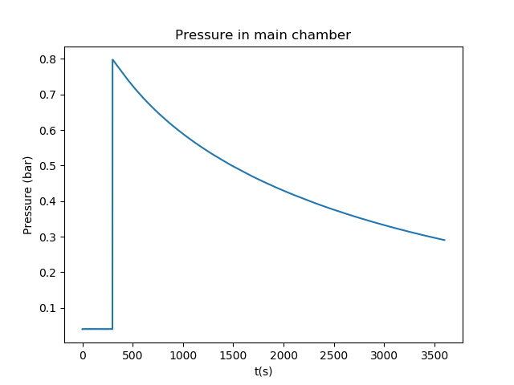
Measurement of pressure drop velocity
Start at 7.9V
1106_1116_mixing_pressure_test_small_main

Slide 4
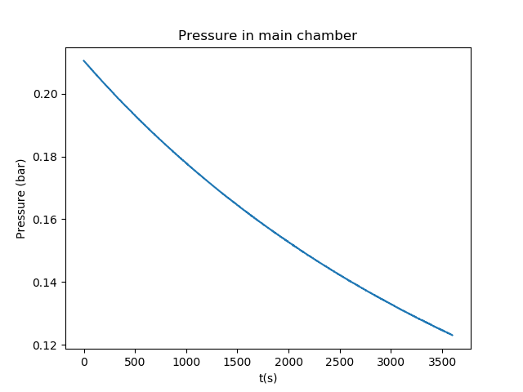
Pressure drop velocity (2)
1106_1244_mixing_pressure_test_small_main_continuation

Slide 5
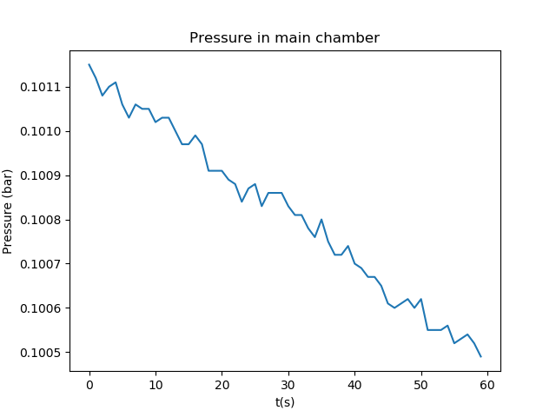
Pressure drop velocity (3)
1106_1412_mixing_pressure_test_small_main_continuation

Slide 6
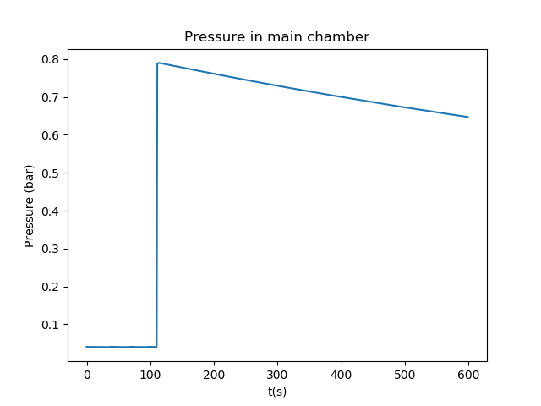
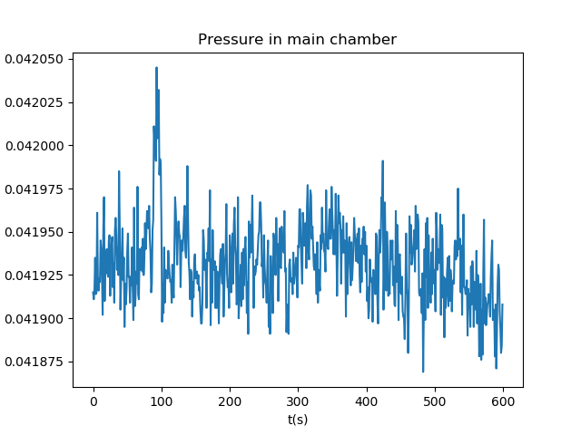
Magnitude of the pressure drop
Complete drop down to maximally achievable vacuum (0.04 bar)
1106_1637_mixing_pressure_test_small_main_long_start
1107_1046_mixing_pressure_test_small_main_long_start

Slide 7
Cause?
The amount of air is fixed, so every volume of air that is pumped away does not get replenished.
Leaks cannot cause this as the system is at a lower pressure than the surrounding air and therefore these should only increase the pressure
Therefore I conclude that the pressure controller must pump away air and thus not have its exhaust port complete blocked

